Slide 1
Analyzing the “Woodcorp Order to Cash” Dataset

Slide 2

INTRODUCTION
Company Background:
WoodCorp Inc. manufactures wooden pallets and boxes across multiple locations.
Operates with both automated and non-automated warehouses.
Orders follow an Order-to-Cash (O2C) process that impacts delivery performance.

Slide 3
Dataset Overview: WOODCORP O2C : Activity and Case table Woodcorp O2C Case Table: Contains order details (Order ID, Customer Info, Product Type, Factory, Order & Delivery Dates, etc.). Woodcorp O2C Activity Table: Captures each stage of the order process from Order Creation to Payment, with timestamps.

Slide 4

PROBLEM STATEMENT
Challenges in On-Time Delivery (OTD): Late deliveries result in penalties and customer dissatisfaction.
Warehouse Automation vs. Non-Automation: Efficiency differences affecting performance.
Late Delivery Penalties : Delayed shipments result in financial losses due to penalty deductions.
Need for a Data-Driven Approach: Process mining is required for actionable insights.

Slide 5
OBJECTIVES
Discover and analyze the O2C process flow.
Identify root causes of delays and inefficiencies.
Improve On-Time Delivery (OTD) performance to 80%.

Slide 6

Key Insights
● Total Deliveries: 19,953 | Late Deliveries: 6,865 | On-Time Delivery Rate: 65.59%
● Highest Late Deliveries & Fees: Essen (€1.18M) and Aachen (€445K)
● Automation Impact: Non-automated warehouses caused 99.8% of late deliveries
● Peak Late Delivery Months: May (806) & June (782)
● Higher Order Volume → Higher Late Fees: +30% orders increase fees to €1.53M

Slide 7
Business Case – Cost Impact Analysis
Target On-Time Delivery (OTD): 80%
Current OTD Performance: 65.59%
Cost of Late Deliveries:
Every late KG costs WoodCorp: €0.75.
Estimated annual loss due to late deliveries: 1.75M €

Slide 8
Visualization and KPIs

Slide 9
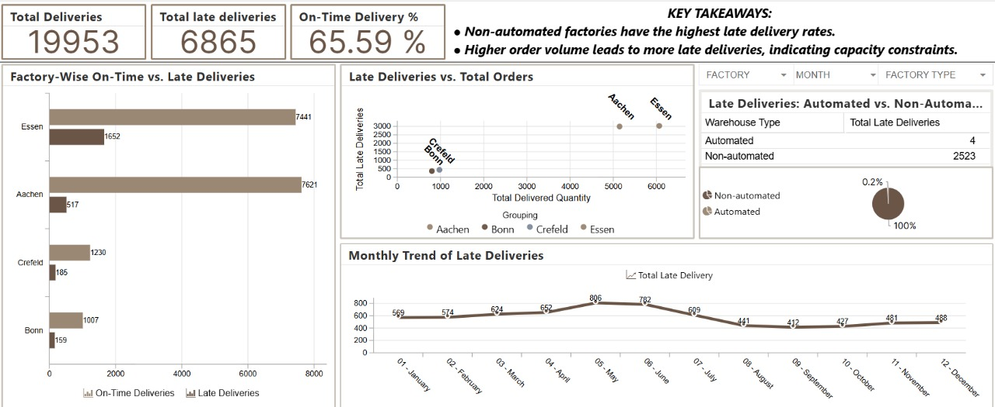

Slide 10
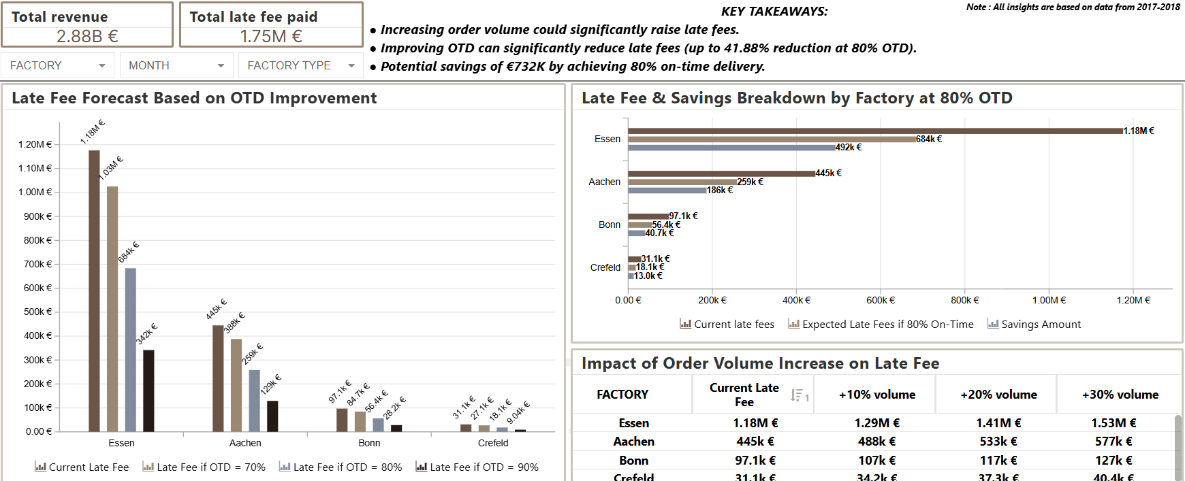

Slide 11
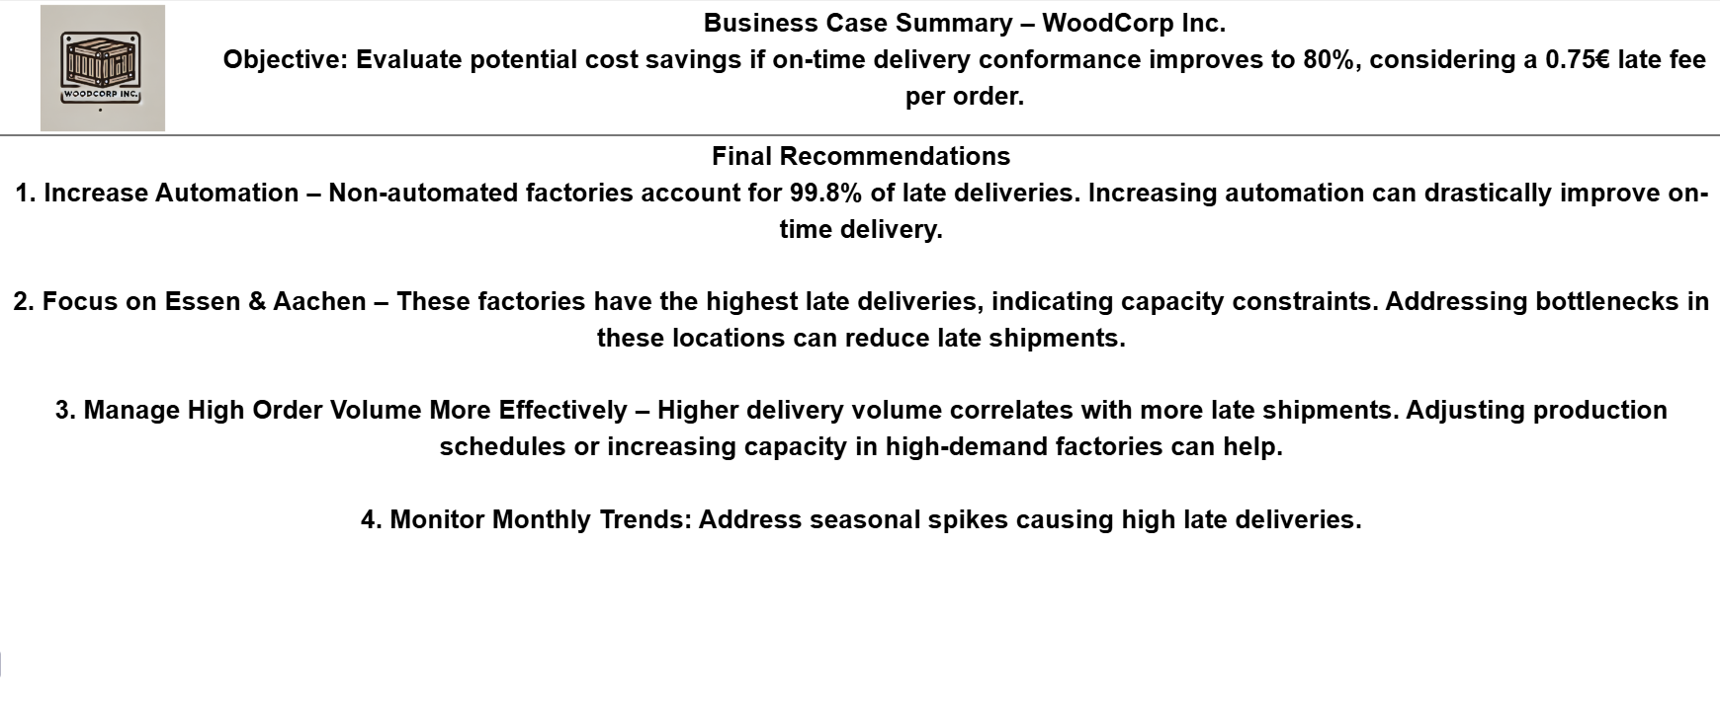

Slide 12
Final Recommendations
Increase Automation – Non-automated factories account for 99.8% of late deliveries. Shifting more operations to automated warehouses can significantly improve on-time delivery.
Focus on Essen & Aachen – These factories have the highest late deliveries, indicating capacity constraints. Addressing bottlenecks in these locations can reduce late shipments.
Manage High Order Volume More Effectively – Higher delivery volume correlates with more late shipments. Adjusting production schedules or increasing capacity in high-demand factories can help.
Monitor Monthly Trends: Address seasonal spikes causing high late deliveries.

